Slide 1





Connect ez
Team members:
Adithya A S - [cb.en.u4cce19004]
Nitesh J - [cb.en.u4cce19039]
Vishwanathan S - [cb.en.u4cce19064]

Slide 2
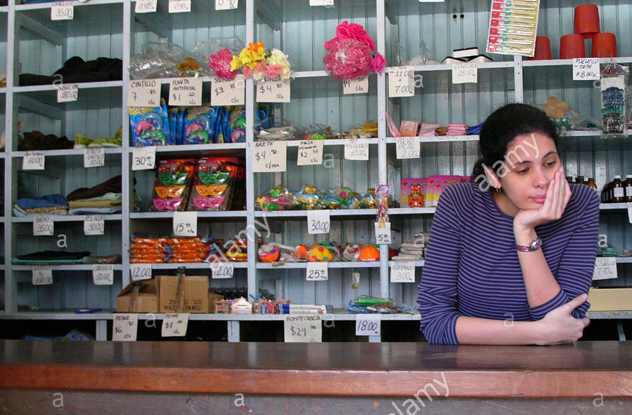


Many sellers fail to sell their products, as they couldn't find the appropriate buyers.
Buyers couldn't find a seller who sells the product which they need.
Existing apps couldn't deliver the product at the right time when customer need

Slide 3



Efficient app for local buyers and sellers for both retail and wholesale
Consumers don’t need to worry about the safety of the product.

Slide 4
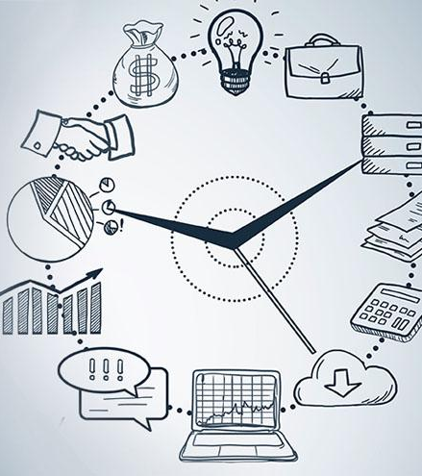
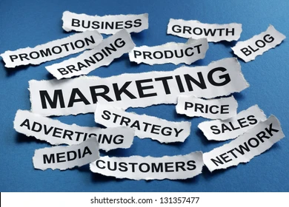
Very Useful for a customer who needs to buy a product immediately .
Sellers can market/advertise their shop

Slide 5

Featurtes
Direct communication between buyer and seller
Easily locate the shops and products around you
Promotion for sellers

Slide 6

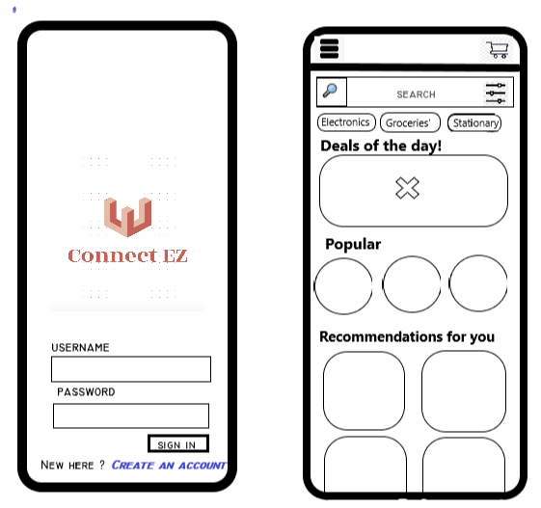
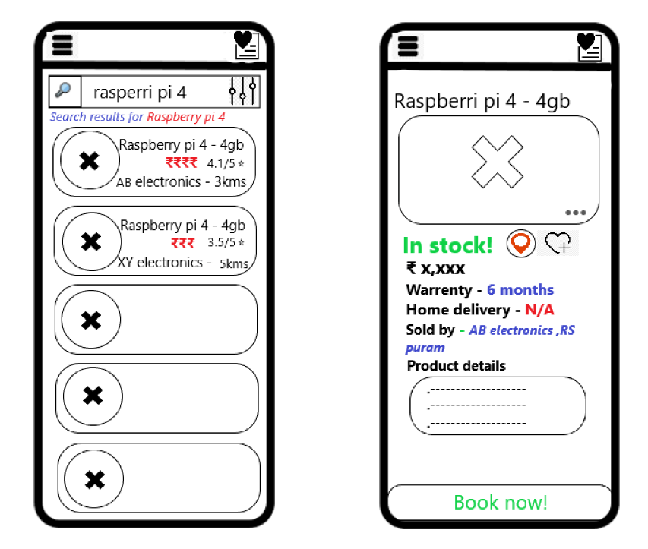
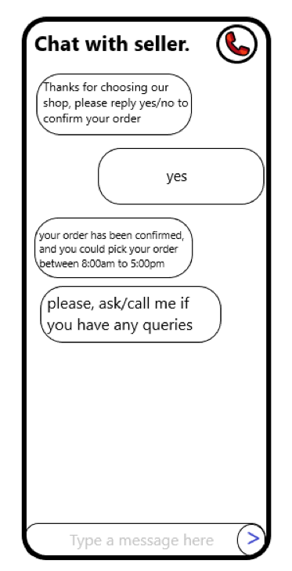
Design

Slide 7

Future scope

